Slide 1

Analyzing Technological Trends in Autonomous Vehicles through Patent Text Mining and Predictive Modeling
First Review
Natural Language Processing
Course Code: CS7610
Course Title: Capstone Project
Guide Name: Prof. Ramya Mohanakrishnan
24MSP3038
Aniket Shinde
03/06/2025

Slide 2
Problem Statement
Patents are a valuable source of early-stage technological insights, offering structured disclosures of innovation across industries. In the rapidly evolving autonomous vehicle (AV) domain, analyzing patent text can reveal emerging trends, key technologies, and innovation gaps. This project applies Natural Language Processing (NLP) to extract structured knowledge from AV-related patents. By identifying key terms and relationships, we build semantic representations of each document. These are then used in machine learning techniques such as clustering and dimensionality reduction to uncover hidden patterns and technology clusters. The goal is to demonstrate how AI-driven patent analysis can support trend forecasting and strategic R&D planning in the AV space.

Slide 3
Objectives
Construct a structured and comprehensive dataset
Gain foundational insights into the patent corpus
Uncover high-level trends using NLP methods
Develop structured, machine-interpretable features
Apply and evaluate predictive models

Slide 4
Review of Related Literature
Base Paper
Author Name: Amy J.C. Trappey, Charles V. Trappey, Jheng-Long Wu, Jack W.C. Wang
Title of the Paper: Intelligent compilation of patent summaries using machine learning and natural language processing techniques
Journal Title: Advanced Engineering Informatics
Year of Publication: 2020
Methodology used: artificial intelligence, natural language processing, deep learning, and machine learning to automatically summarize patent documents, evaluated using ROUGE metrics to ensure high precision and recall
Outcomes: The developed AI-based solution accurately summarizes patent documents with high precision and recall, effectively identifying key information and achieving performance comparable to human experts, ultimately saving time and cost in IP technology identification.
Point taken into consideration for your methodology: Sequence to Sequence with Attention and Doc2Vec, alongside rigorous evaluation using ROUGE metrics

Slide 5
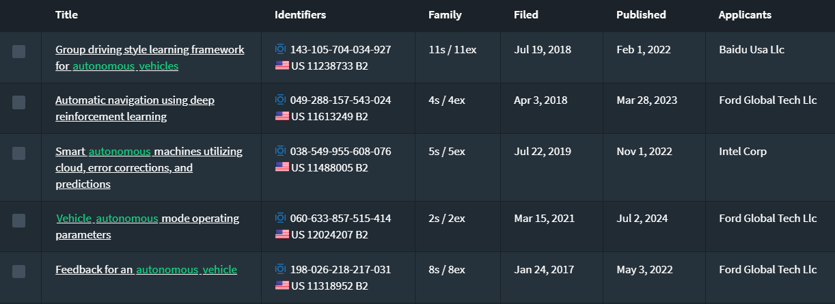
Dataset
Source of the Dataset: lens.org
No. of Observations: 667 patent full-text files
Column/Feature Details: Title, Abstract, Claims, Application Date, Publication Date, Applicants, CPC Codes
Details about the columns – Text data
Screenshot of the dataset:

Slide 6
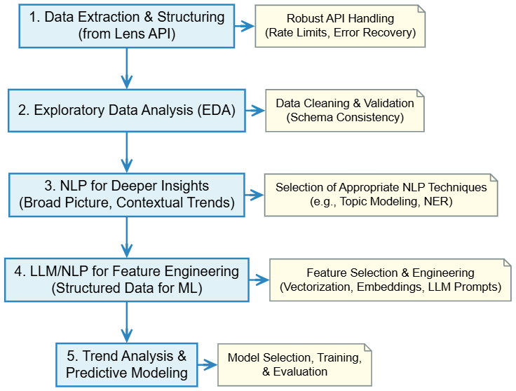
Proposed Methodology

Slide 7
Exploratory Data Analysis
Screenshot of code
Output
Interpretation
Formulation of Research Problem and findings

Slide 8
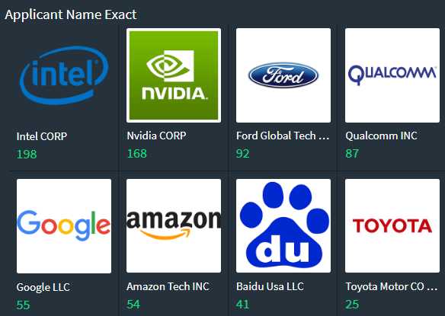
Exploratory Data Analysis

Slide 9
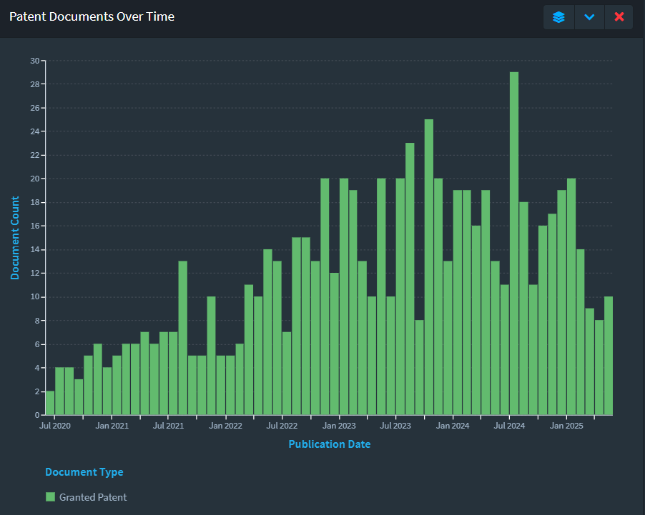
Exploratory Data Analysis

Slide 10
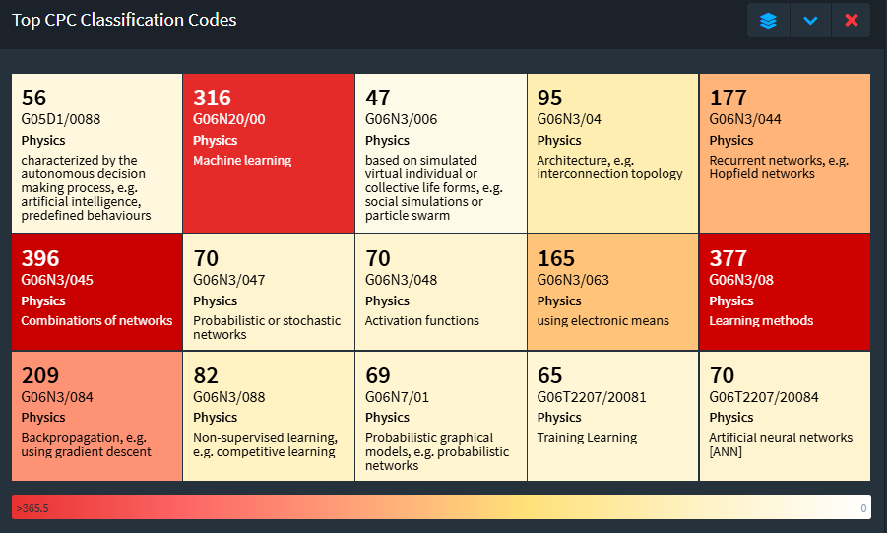
Exploratory Data Analysis

Slide 11
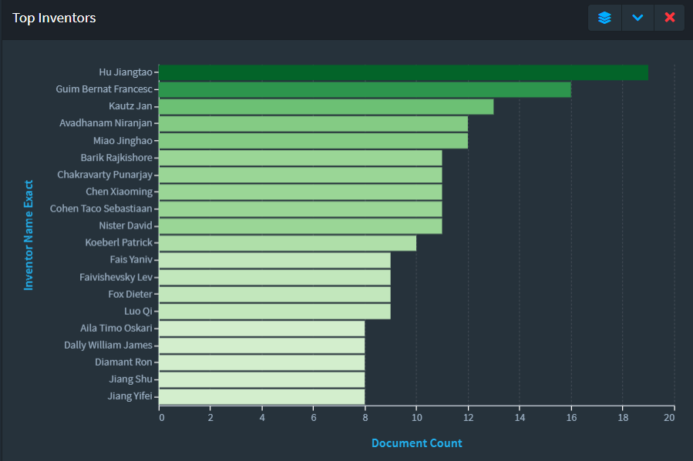
Exploratory Data Analysis

Slide 12
Next Step of Research Focus
Selection of NLP techniques to understand broader themes in autonomous vehicle research
Restructure data to prepare a pipeline for further ML operations
Develop a system for trend analysis and predictive modeling

Slide 13
Conclusion
The extracted patent data has been successfully structured and analyzed, revealing consistent formatting across documents and highlighting key players, technological trends, and classification patterns. These early findings establish a strong foundation for deeper NLP-driven insights and subsequent machine learning applications in the next phases.

Slide 14
References : APA format
Base Paper:
Trappey, A. J. C., Trappey, C. V., Wu, J.-L., & Wang, J. W. C. (2020). Intelligent compilation of patent summaries using machine learning and natural language processing techniques. Advanced Engineering Informatics, 43, 101027. https://doi.org/10.1016/j.aei.2019.101027
Link to Paper
Paper I:
Cho, R. L. T., Liu, J. S., & Ho, M. H. C. (2021). The development of autonomous driving technology: perspectives from patent citation analysis. Transport Reviews, 41(5), 685–711. https://doi.org/10.1080/01441647.2021.1879310
Link to Paper
Paper II:
Kim, G., & Bae, J. (2017). A novel approach to forecast promising technology through patent analysis. Technological Forecasting and Social Change, 117, 228–237. https://doi.org/10.1016/j.techfore.2016.11.023
Link to Paper
Paper III:
Lattimer, B., Chen, P. H., Zhang, X., & Yang, Y. (2023). Fast and accurate factual inconsistency detection over long documents. In H. Bouamor, J. Pino, & K. Bali (Eds.), Proceedings of the 2023 Conference on Empirical Methods in Natural Language Processing (pp. 1691-1703). Association for Computational Linguistics. https://doi.org/10.18653/v1/2023.emnlp-main.105
Link to Paper

